Slide 1






Credit Card prediction

Slide 2



Today's Focus
Problem description
project objective
Data Information &EDA
Data Visualisation
Remediate Imbalance using SMOTE
One Hot encoding
Feature engineering
ML models

Slide 3




This ML project aims to predict customers who will default on a loan. Banks may experience loss on credit card products from various sources, and one possible reason for the loss is when customers default on their debt, preventing banks from collecting payments for the services rendered
Problem Description

Slide 4

Project
Objective
The primary goal of this project is to develop a predictive model that identifies which customers are at risk of defaulting on their credit card payments in the upcoming months. This will enable banks to proactively manage risk by identifying potential defaulters early and taking preventive actions to mitigate financial losses.

Slide 5

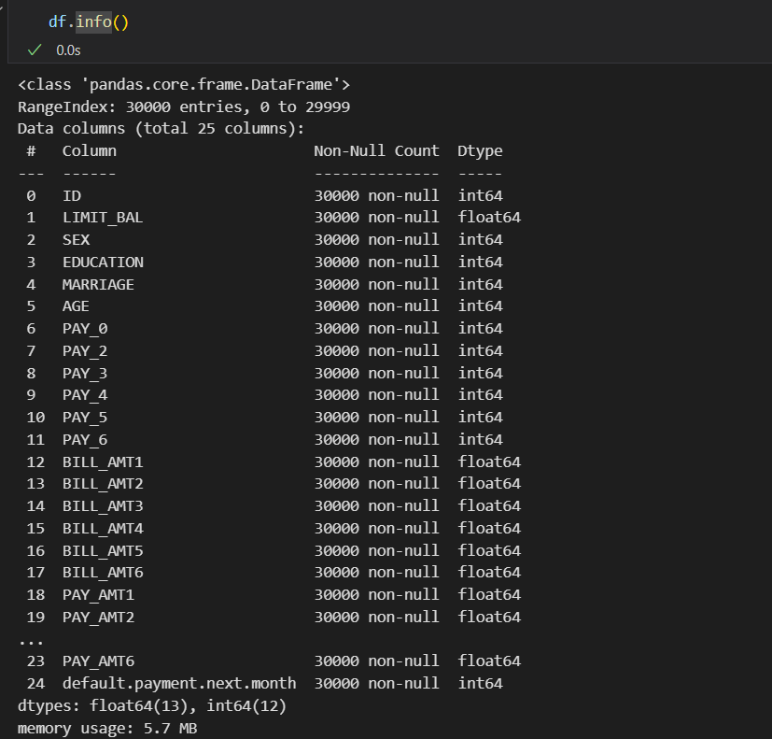
Data Information

Slide 6

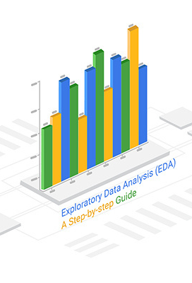
Exploratory Data Analysis
EDA is a critical step to understand the dataset before model building.
Key activities include :
Summary Statistics
Visualizations
Outlier Detection

Slide 7


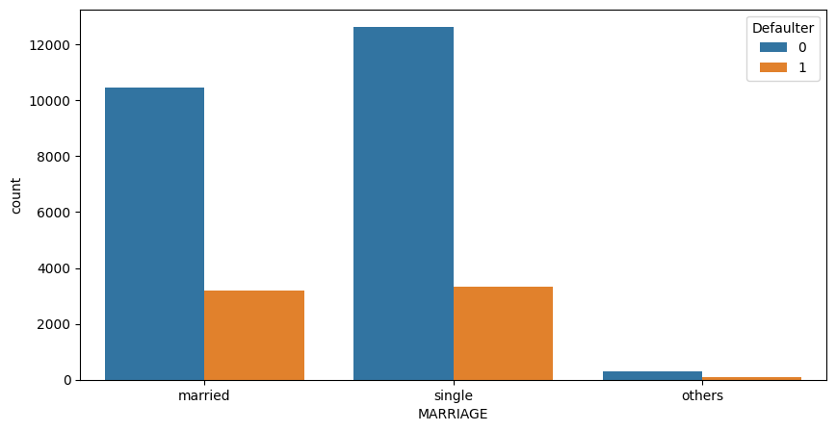
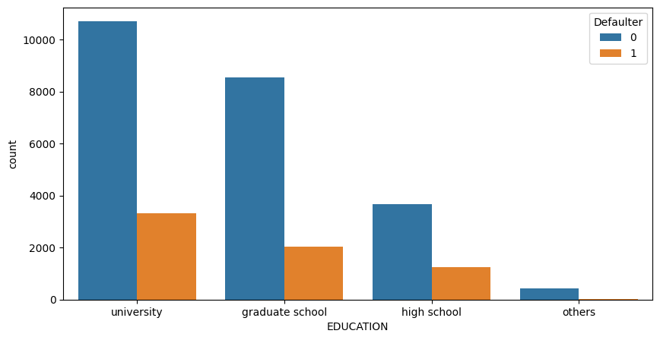
Data Visualization on Categorical Data

Slide 8
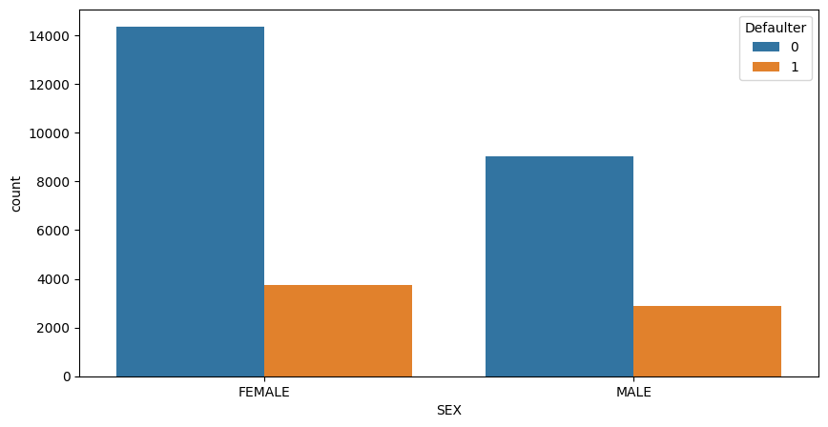
Data Visualization on Categorical Data

Slide 9
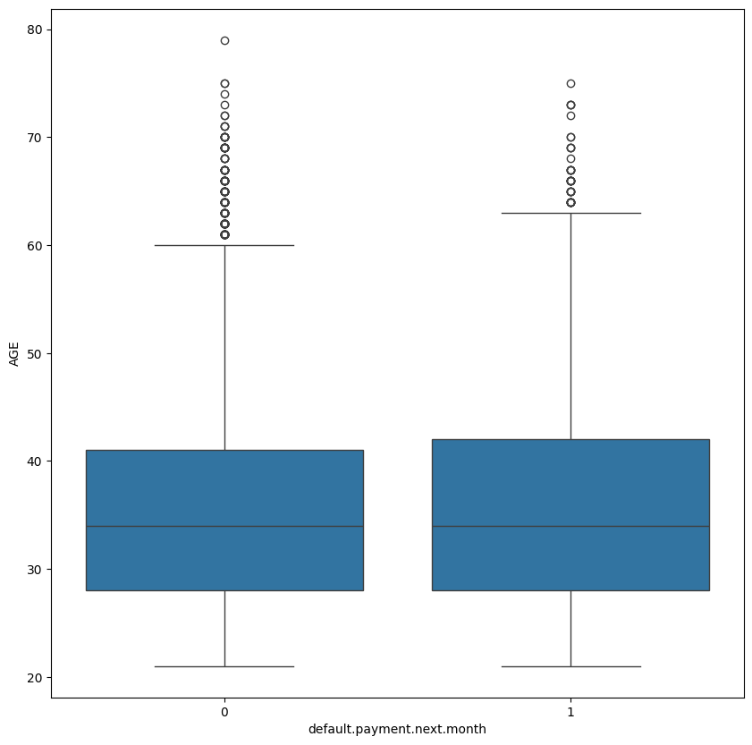
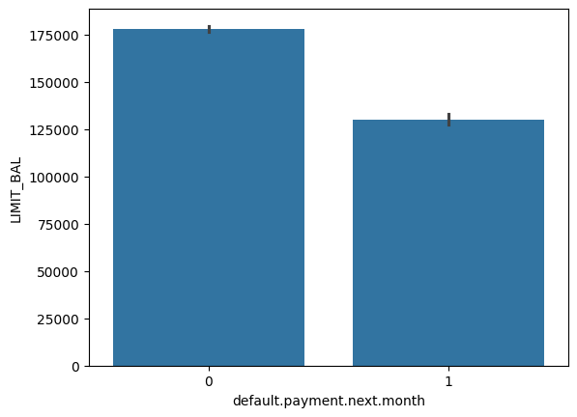
Data Visualization on Numerical Data

Slide 10
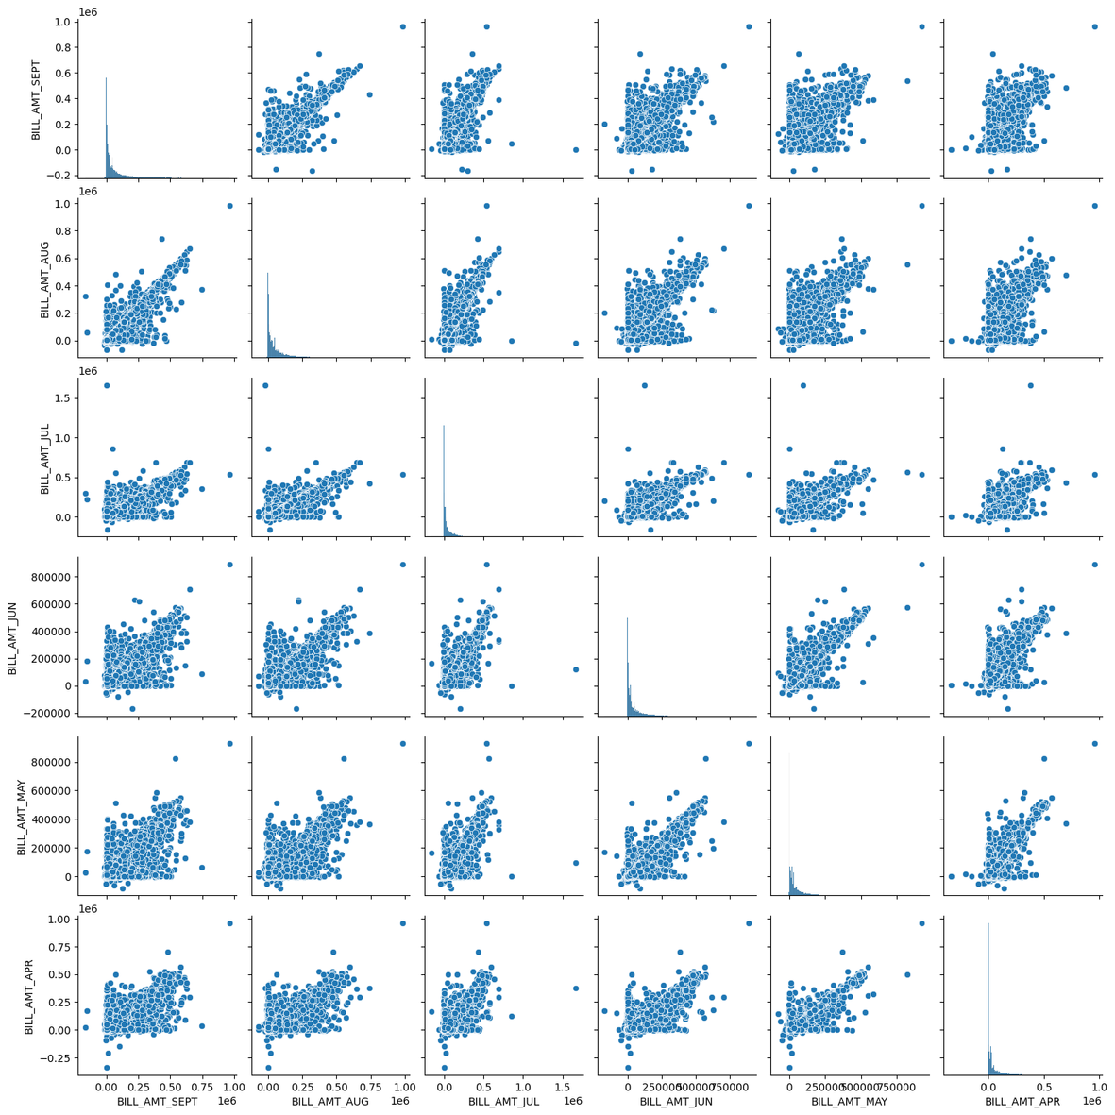
BILL AMOUNT

Slide 11
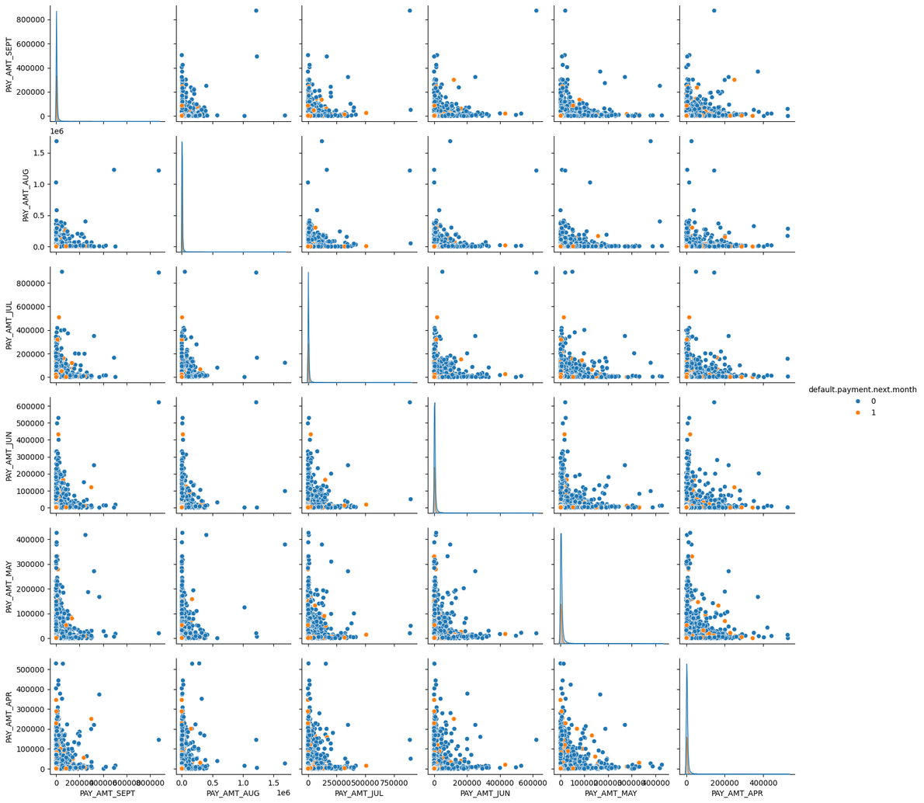
Paid AMOUNT

Slide 12


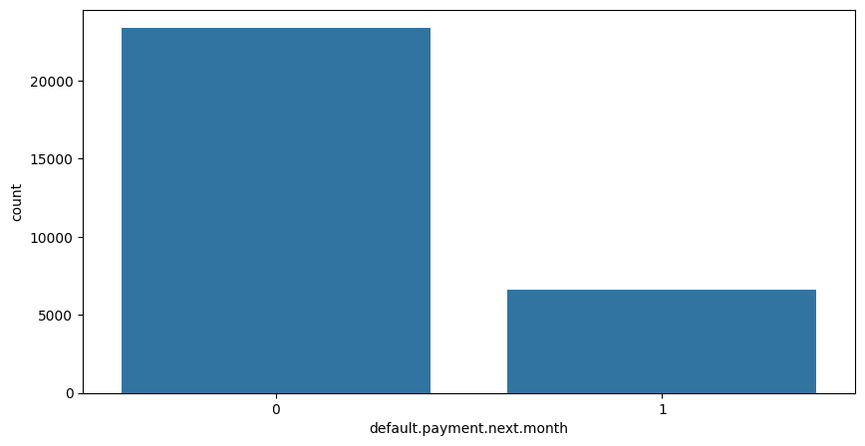
Data Distribution Before Applying SMOTE
"The original dataset shows a strong imbalance between customers who did not default (Class 0) and those who defaulted (Class 1). This imbalance may cause the model to focus more on predicting non-default cases, leading to poor accuracy for default predictions."

Slide 13
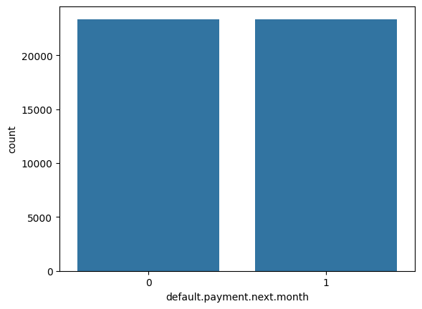
After SMOTE
Original dataset shape 30000
Resampled dataset shape 46728

Slide 14
Feature engineering refers to manipulation, addition, deletion, combination of your data set to improve machine learning model training, leading to better performance and greater accuracy
we created new features such as Payment_Value and Dues .
Feature Engineering

Slide 15





One Hot Encoding
Initial One-Hot Encoding
Apply one-hot encoding to the columns EDUCATION and MARRIAGE using pd.get_dummies().
This creates binary columns for each category in those columns.
Drop Unwanted Columns
Remove the columns EDUCATION_others and MARRIAGE_others to eliminate redundancy.
Further One-Hot Encoding
Apply one-hot encoding to additional columns: PAY_SEPT, PAY_AUG, PAY_JUL, PAY_JUN, PAY_MAY, and PAY_APR.
Use the drop_first=True parameter to avoid the dummy variable trap (multicollinearity).

Slide 16
One Hot Encoding
Encoding Categorical Variables
Replace the SEX column values with numerical representations: FEMALE as 0 and MALE as 1 using dictionary.
Drop Identifier
Remove the ID column from the DataFrame, as it is not needed for analysis

Slide 17
ML Model
 | logistic regression | Decision tree classifier | Random Forest | XG boost
Accuracy | 0.75383 | 0.74727 | 0.83586 | 0.82281
precision | 0--> 0.73 1 --> 0.79 | 0--> 0.75 1 --> 0.74 | 0--> 0.82 1 --> 0.86 | 0--> 0.80 1 --> 0.85
recall | 0--> 0.82 1 --> 0.69 | 0--> 0.74 1 --> 0.76 | 0--> 0.87 1 --> 0.80 | 0--> 0.86 1 --> 0.78
f1-score | 0--> 0.77 1 --> 0.74 | 0--> 0.74 1 --> 0.75 | 0--> 0.84 1 --> 0.83 | 0--> 0.83 1 --> 0.82

Slide 18


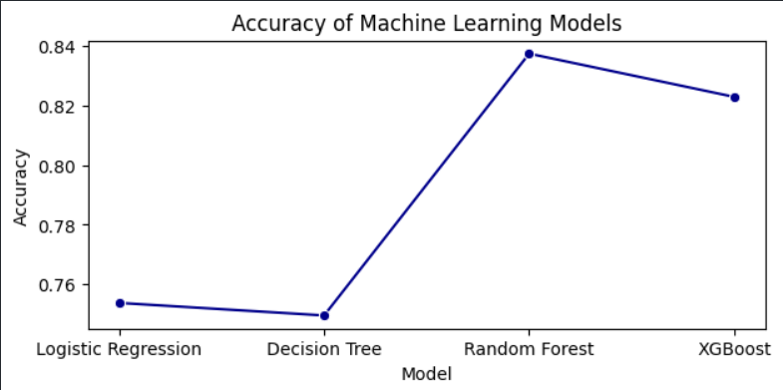

Slide 19
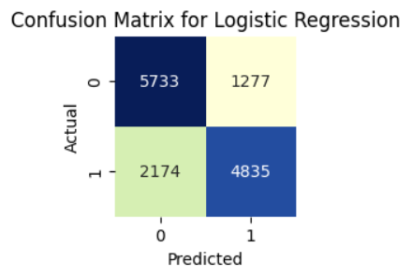
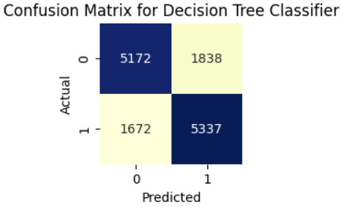
Confusion Matrix

Slide 20
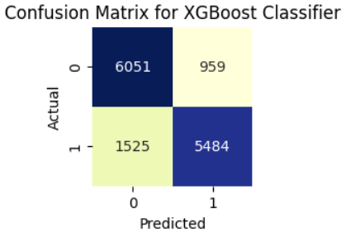
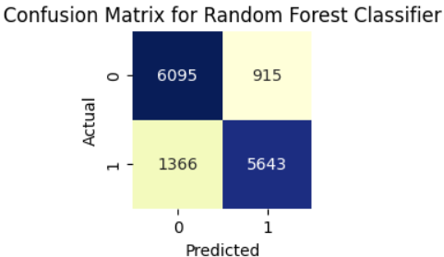
Confusion Matrix

Slide 21
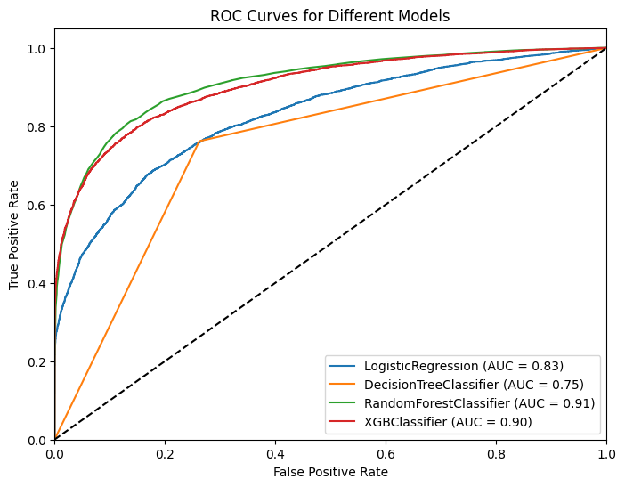

Slide 22




Random forest
Random Forest is an ensemble learning method that combines multiple decision trees to improve predictive accuracy and control overfitting.
Key Features of Random Forest
Ensemble Method
Bootstrap Aggregating (Bagging)
Random Feature Selection
Robustness to Overfitting
Feature Importance

Slide 23






Team members
Safaa Waleed Mohamed
Aya Ibrahem Hassan
Aya Shaker
Shahd Hamza

Slide 24




Thank You

